Slide 1
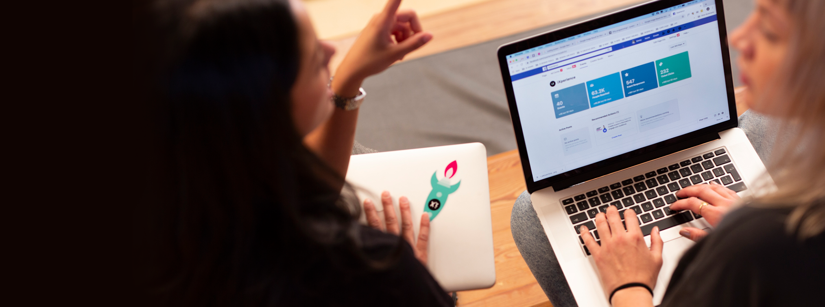

Pre-work
iX Remote
Time to get into the iX mindset! In this part, you’ll have to setup your computer, tell your teachers about you and your interests, and submit an assignment that will introduce you to some of the foundational theory and practical skills in this course.
Computer Setup
To make sure you are ready for class on Day 1, please make sure you do the following. If you have any questions or issues, please reach out to us by email immediately.
For this class you will not need any specific computer setup or application downloaded.
Introduce yourself
We can’t wait to get to know you better! Please upload your current resume HERE.
In addition, please tell us a bit more about yourself by filling out this form. The form includes simple questions that will help us get to know you better before the classes start and we meet in-person virtually. Filling out this form shouldn’t take you more than 20-mn.

Slide 2
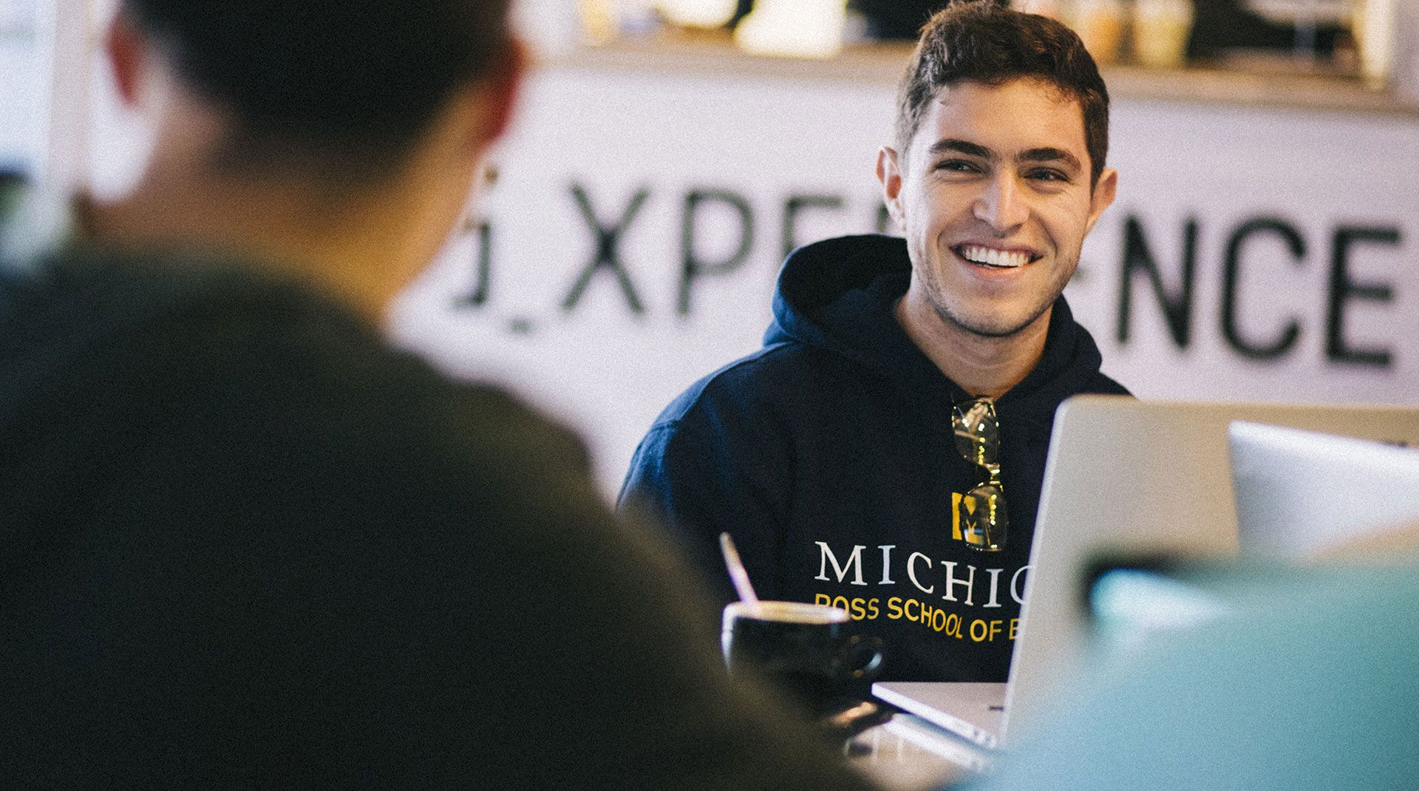
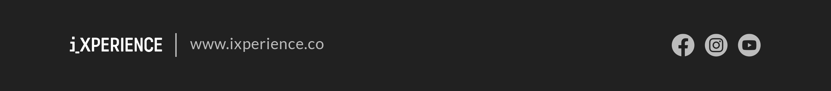
Your assignment
Before we meet in the class, please ensure that you complete the following assignments.
Please read the below articles & reports that cover Blockchain and Bitcoin, how they work and why blockchain is one of the most advanced technologies. This material also covers what is cryptography and how applicable it is to the blockchain technology. Click on the links below to access the article and video :
The Truth about Blockchain (17 pages)
How Bitcoin works (22 minutes video)
Summary of Cryptography (15 pages)
We will be covering a few programming concepts and applications related to Blockchain in the next few weeks. For students who are not familiar with the basic programming and coding syntax, please watch this video tutorial (2 hours).
Please review the Remix IDE platform in the following video tutorial to familiarize yourself with this popular blockchain coding tool as we will be using it in later in the course. Click HERE to access this 7-mn tutorial.
It is also important to stay up to date with current affairs. Many people have heard of Bitcoin and Ethereum, which are the two most popular cryptocurrencies. However, there is a rising crypto which is currently the third largest crypto. Please watch this 2-mn CNBC short clip about Tether, the third largest crypto today.
Recently there was a big dip in Bitcoin value when Elon Musk decided to tweet against it. Watch this 5-mn CNBC short clip to understand why Elon Musk decided to pull out of Bitcoin.
To complement your studies, below are some additional optional reading materials for you to go through. The first reading was co-authored by your Head Teacher, Othalia Doe-Bruce.
Crypto Finance and Mechanisms of Exchange
Crypto Assets
After completing all the readings and watching all the videos, finish your pre-work assignment by completing this short quiz before class.
iX 2021

